Slide 1
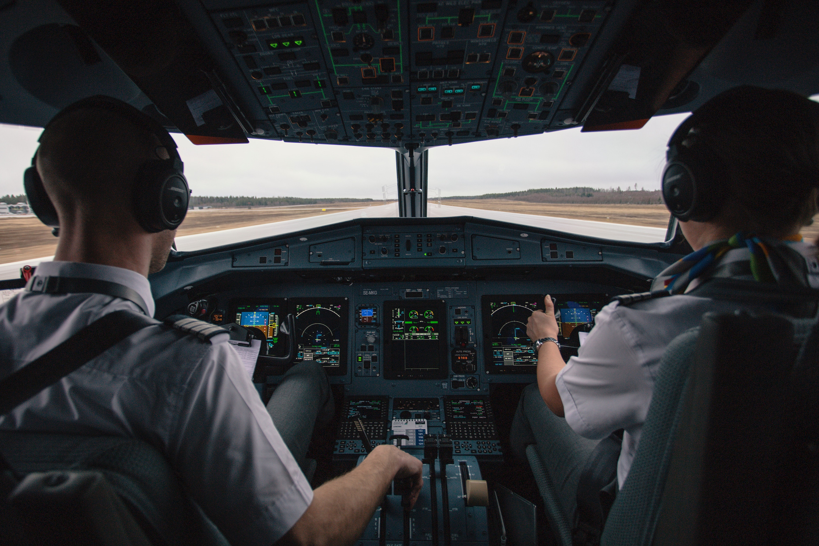

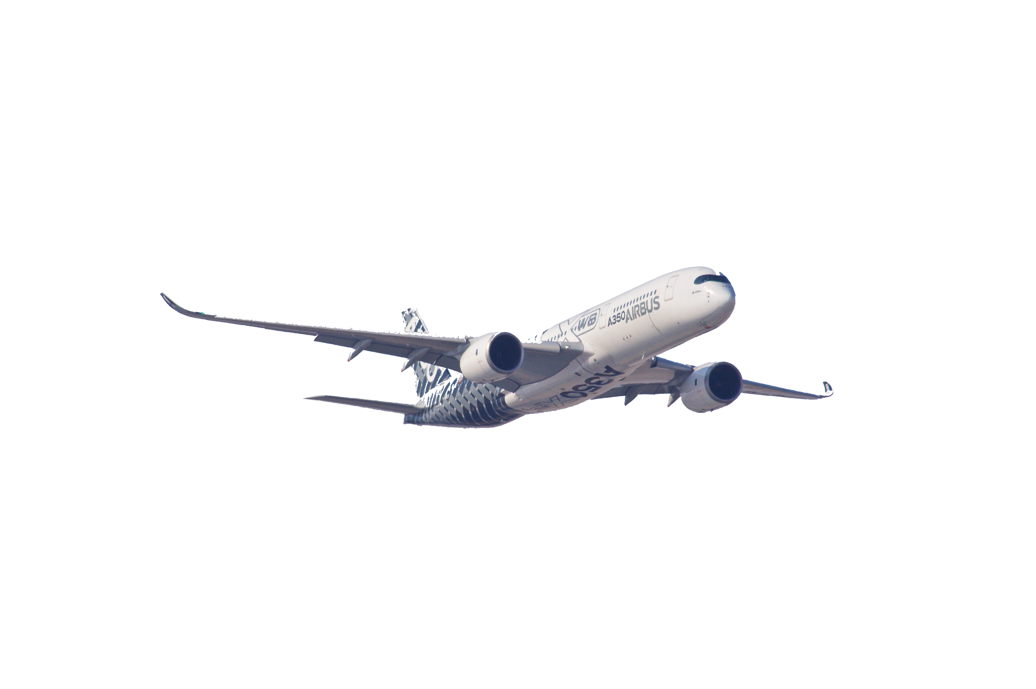


BRIAN PARK, VINA LIU, TIFFANY CHEN, AKHIL NAIR, JANICE ZOU, LORELEI LIU
AIRLINE
SATISFACTION
TEAM 06

Slide 2
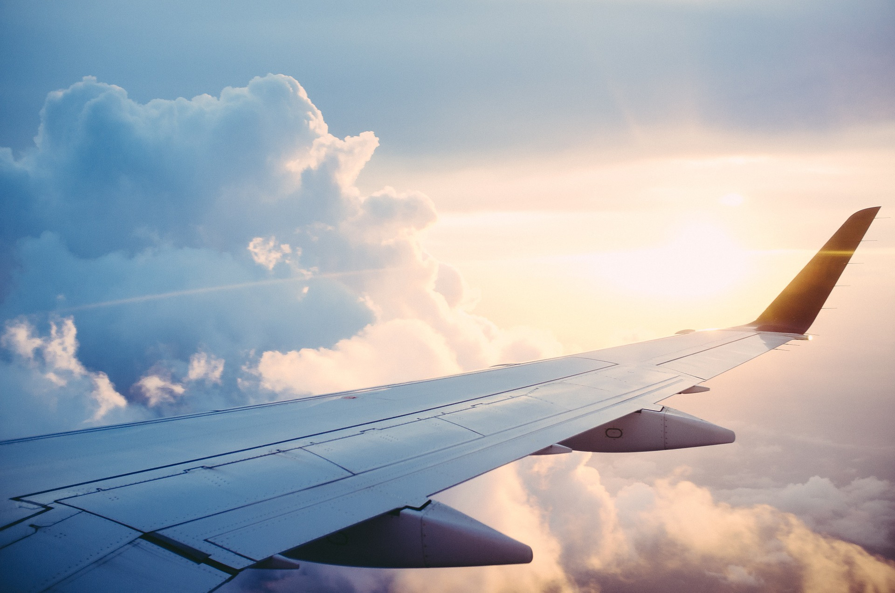

MOTIVATION
INTRODUCTION
According to a report by JP Morgan, the airline industry is all but certain to make gains in 2025, with both revenue and passenger numbers exceeding pre-pandemic numbers. As people that travel often by air, we wanted to examine the factors that go into customer satisfaction. By looking at consumer behaviors to services offered by airlines, we are looking to understand how different customers shape their expectations of travel experiences.
PROBLEM STATEMENT
This project aims to evaluate the customer satisfaction rates of airlines and their services, including but not limited to: delays, amenities, comfort, etc.
We will also evaluate how different consumer demographics respond to loyalty programs, delays, and services provided by airlines.
DATA SOURCE
US Department of Transportation: Air Travel Consumer Reports published monthly by US DoT on commercial airline flight delays, mishandled baggage, oversales, consumer complaints, etc. in pdf format (link)
Skytrax: Contains data on reviews of various airlines, includes full review statements and also details different satisfaction factor ratings. (link)

Slide 3


PART ONE
IDENTIFYING THE CUSTOMERS

Slide 4
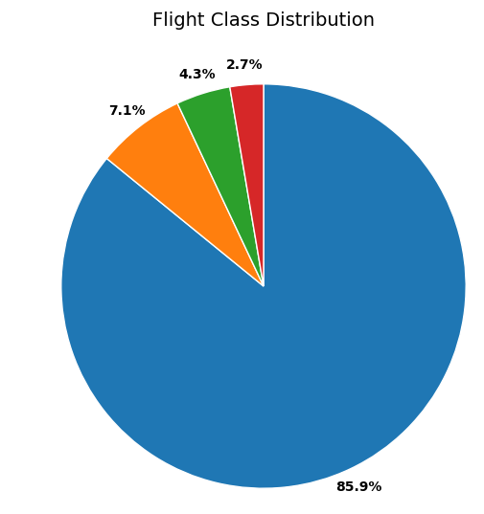
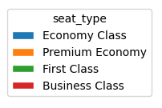
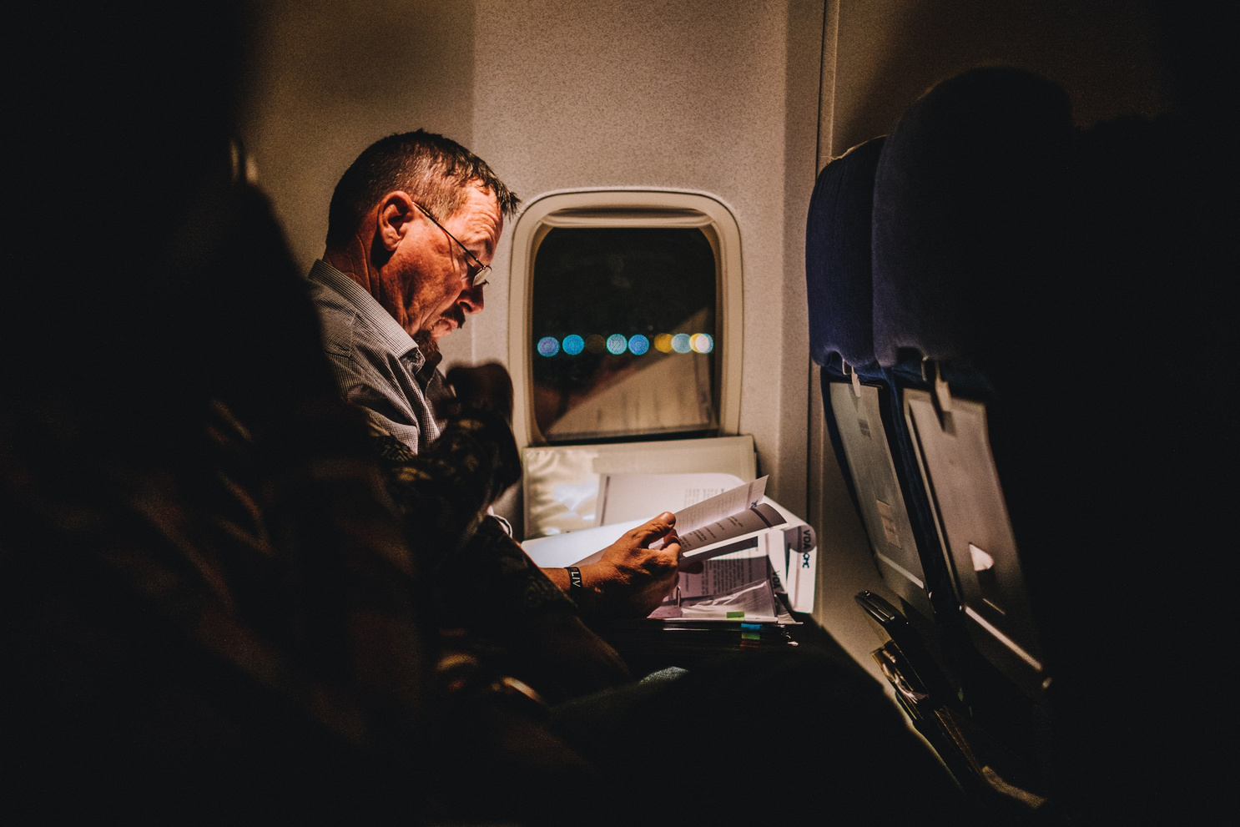
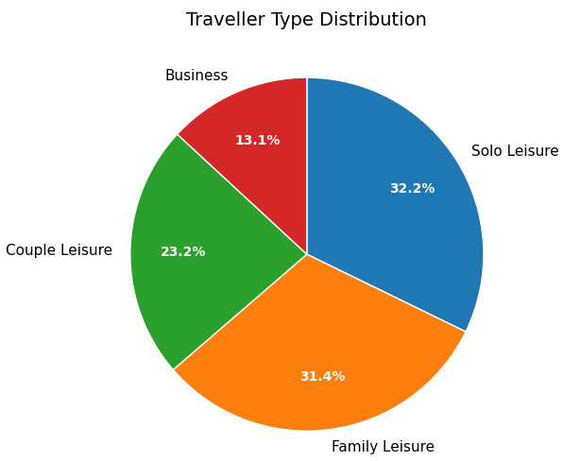
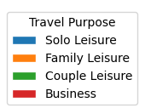
Flight
Class & Travel Purpose Distribution
Most travelers travel by Economy, with most travelling for leisure purposes with loved ones.

Slide 5
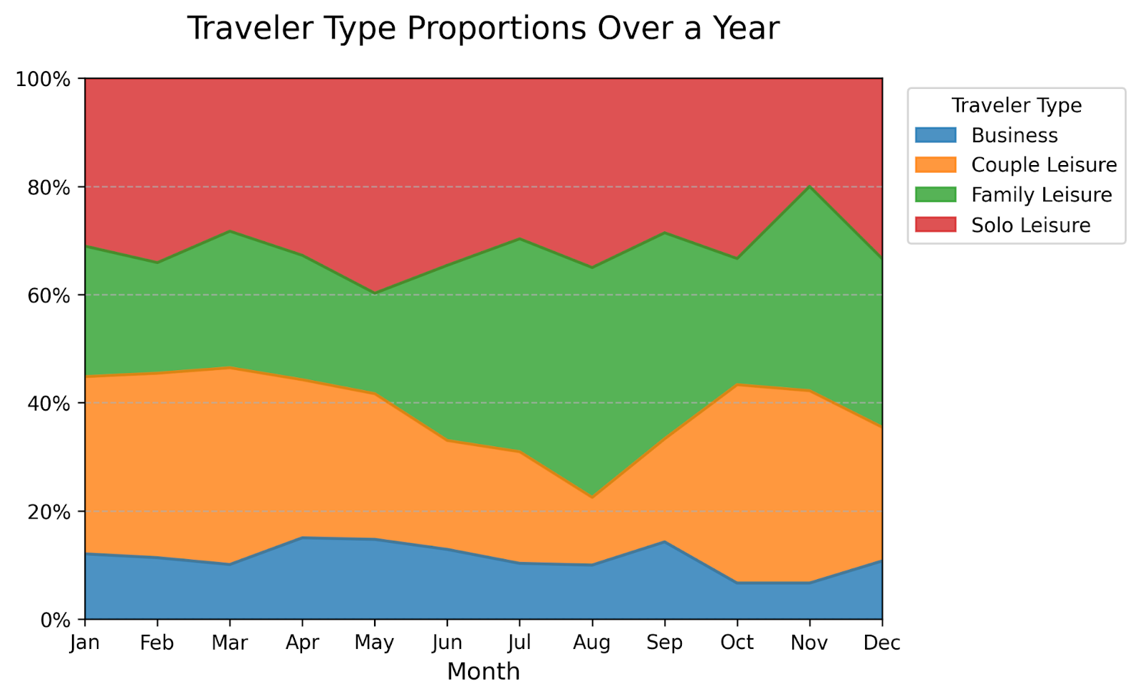
Travel Purpose Distribution
We can see surges in ‘Couple Leisure’ during the off-seasons (Jan-Apr, Sep-Nov), and for ‘Family Leisure’ travellers during the holiday months (Jun-Aug, Nov-Dec).

Slide 6
PART TWO
CUSTOMER SATISFACTION RATES

Slide 7
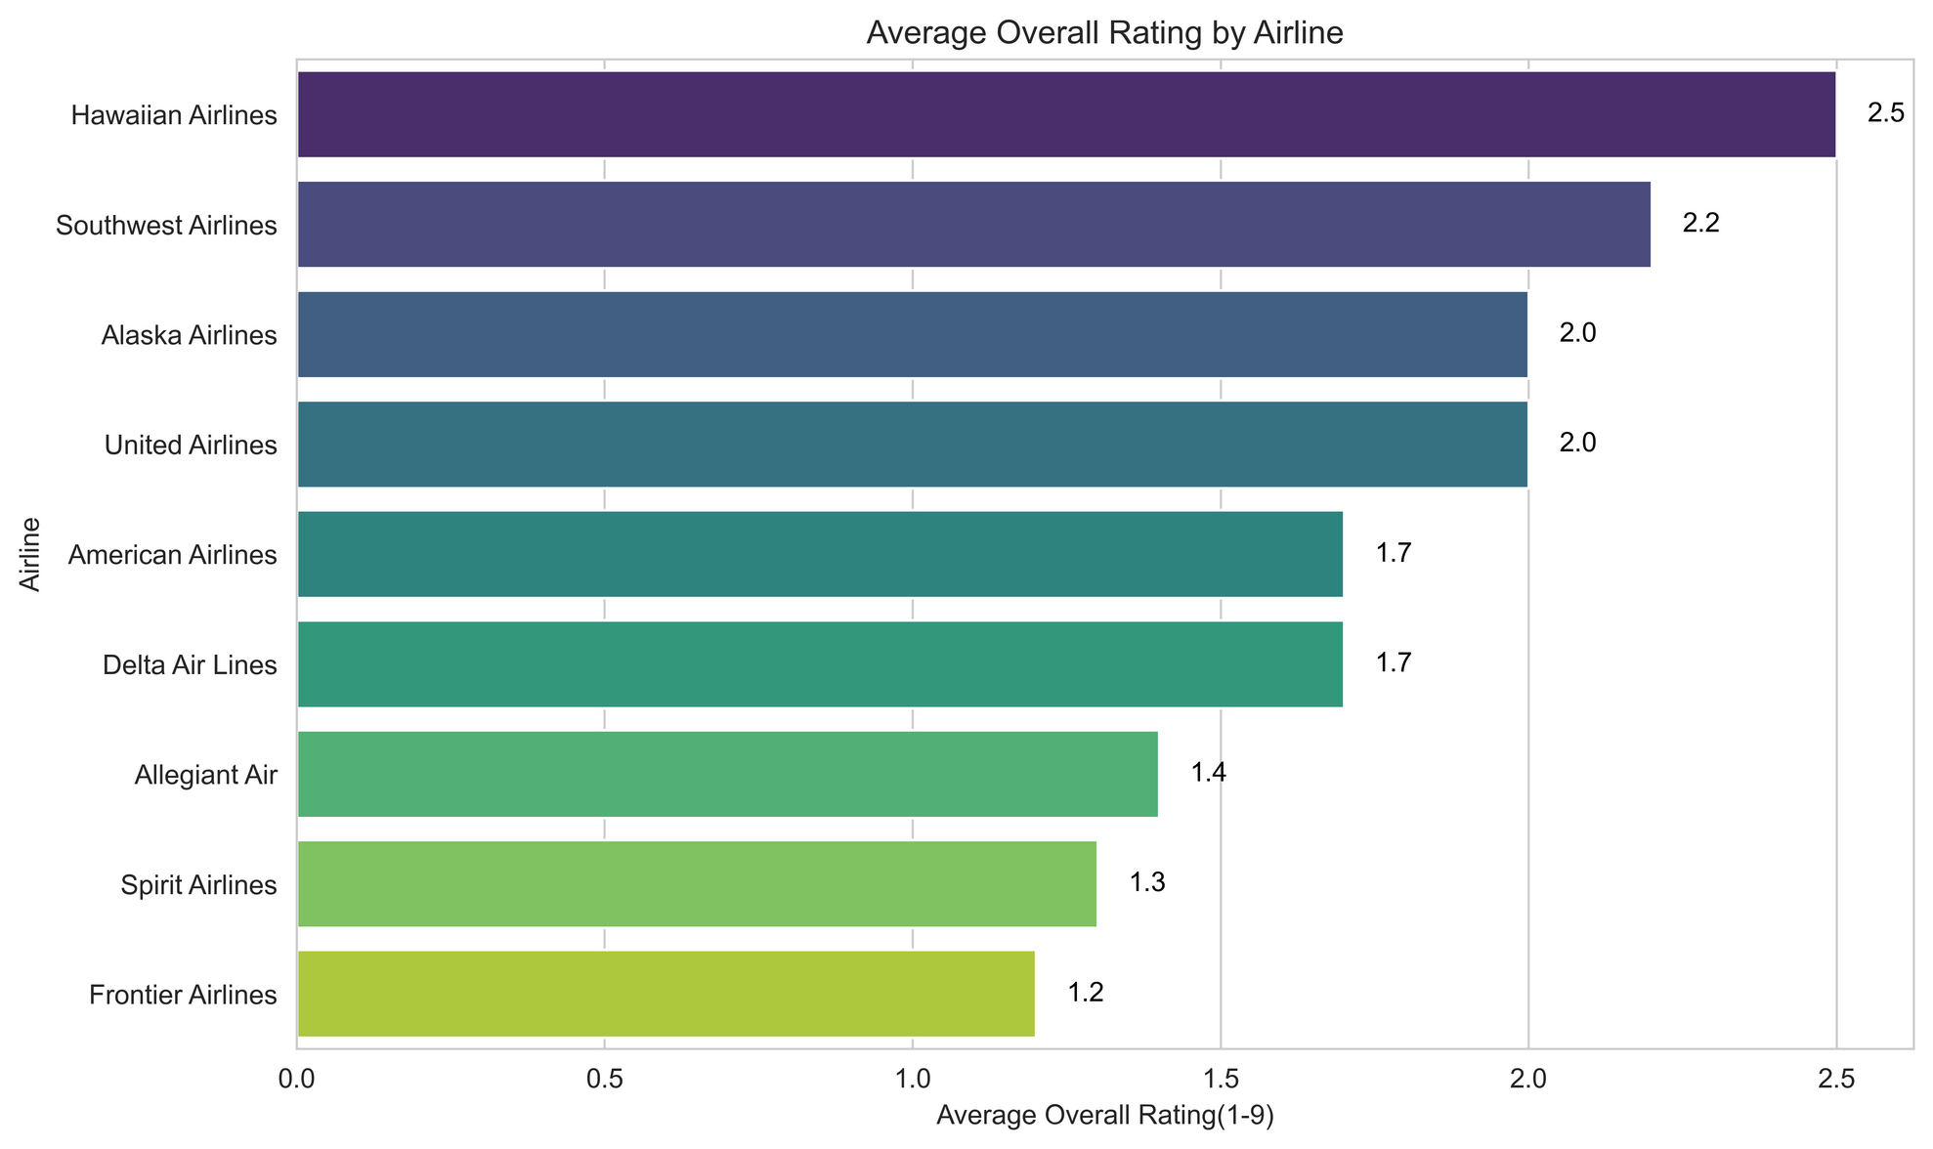
OVERALL RATING BY AIRLINE
The average ratings for U.S. airlines fall between 1.2 and 2.5—far below the maximum score of 10. This suggests that passengers are generally dissatisfied with their airline experience.
These may reflect self-selection bias. Customers who had negative experiences are more likely to leave reviews, while those who were satisfied may not provide feedback.

Slide 8
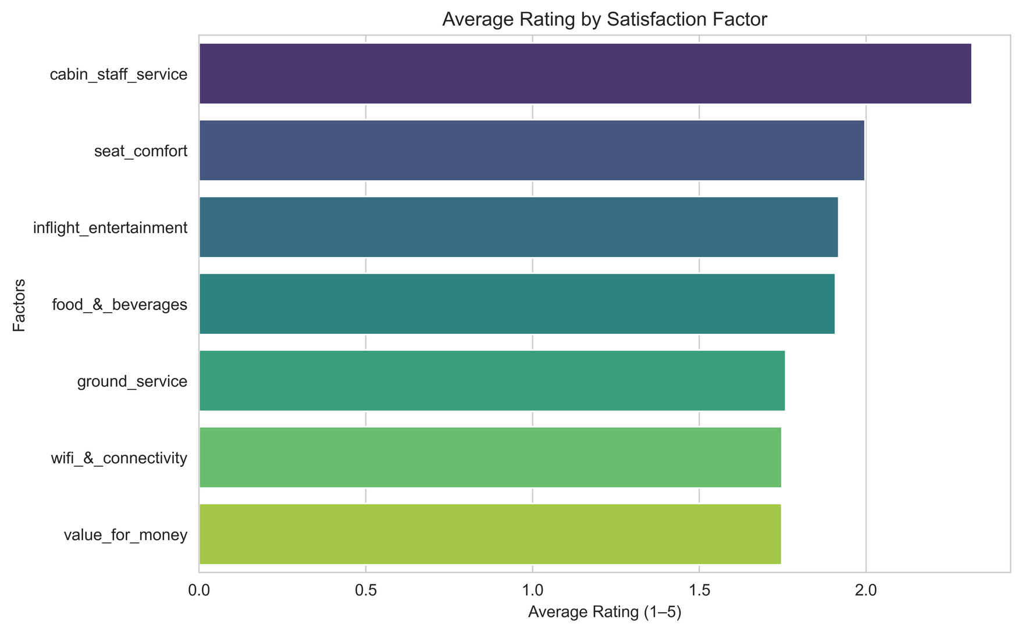
RATING BY SATISFACTION FACTOR
People are relatively more satisfied with the cabin staff service. Lower scores in Wi-Fi, entertainment, and seat comfort indicate that most complaints are driven by amenity issues rather than customer care.
Value for money is rated low, reflecting that passengers don’t feel the flight experience matches the price they paid.

Slide 9
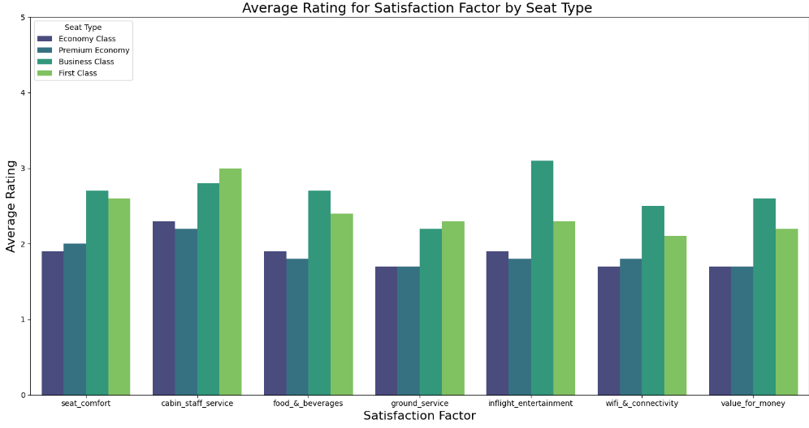
SATISFACTION FACTOR RATING BY SEAT TYPE
First and Business Class receive the highest ratings across most satisfaction factors. Business Class outperforms First Class in some areas, such as entertainment and value for money.
Premium Economy and Economy share similar rating profiles, suggesting that the upgrade may not deliver a significantly enhanced experience across satisfaction factors.

Slide 10
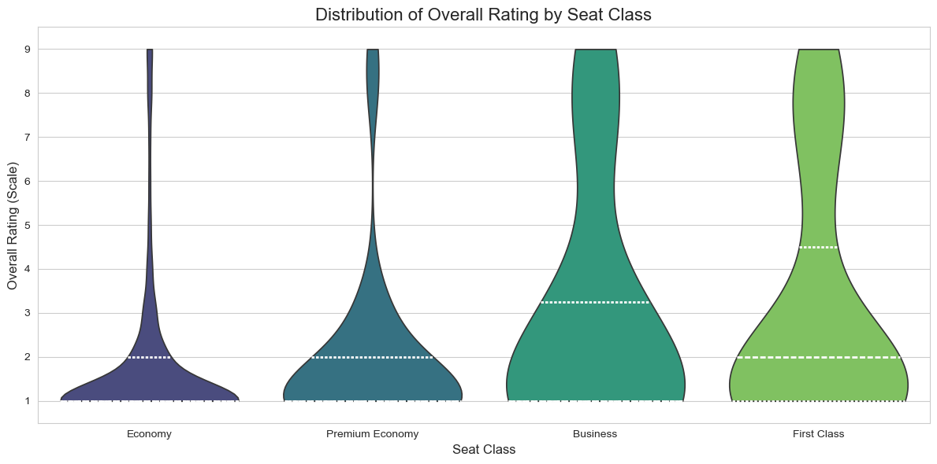
OVERALL RATING BY SEAT CLASS
There are wider, more varied distributions on overall ratings in higher seat classes.
Suggests a dense number of 0-1 ratings in the lower classes (Economy, Premium Economy)
There is also an hourglass shape being formed, which can also be attributed to self-selection bias.
However, the bulge of low ratings for higher classes also suggest higher expectations not met.

Slide 11
PART THREE
SATISFACTION
FACTORS

Slide 12
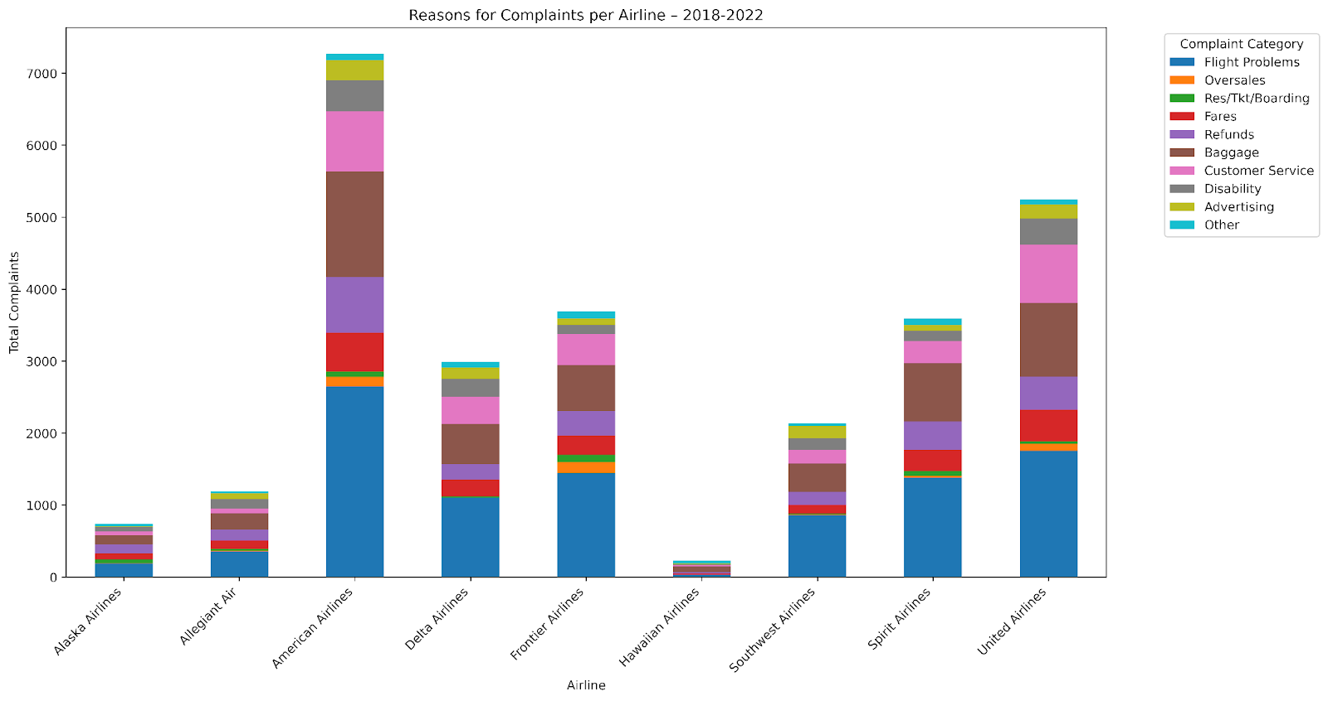
REASONS FOR COMPLAINTS
Data sourced from the U.S. Department of Transportation (DoT).
Hawaiian Airlines had the fewest complaints overall.
American Airlines received the most complaints, followed by United and Frontier.
Top complaint categories:
Flight Problems
Baggage Issues
Customer Service
These areas represent key focus points for improving customer experience.

Slide 13
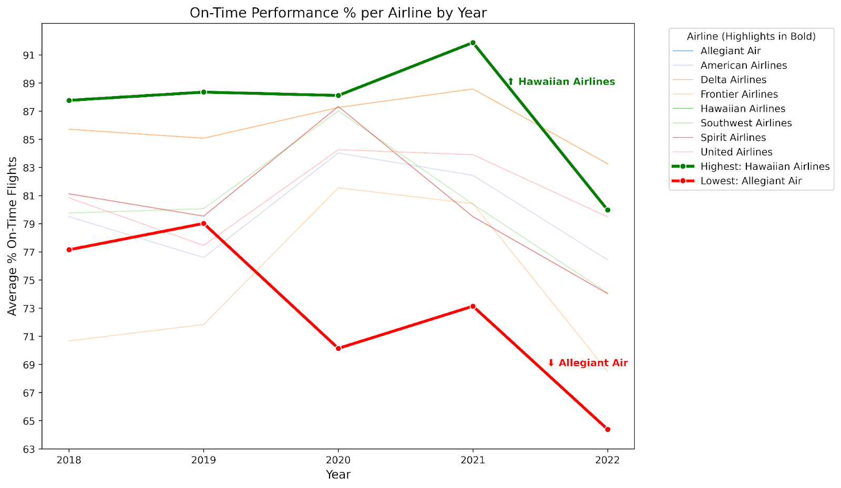
AVG. DELAYS PER AIRLINE
Hawaiian Airlines achieved the highest average on-time performance across the period.
Delta Airlines briefly overtook Hawaiian in 2022.
Allegiant Air recorded the lowest on-time rate (~64%).
Most airlines performed closer to Hawaiian’s consistency than to Allegiant’s low.

Slide 14
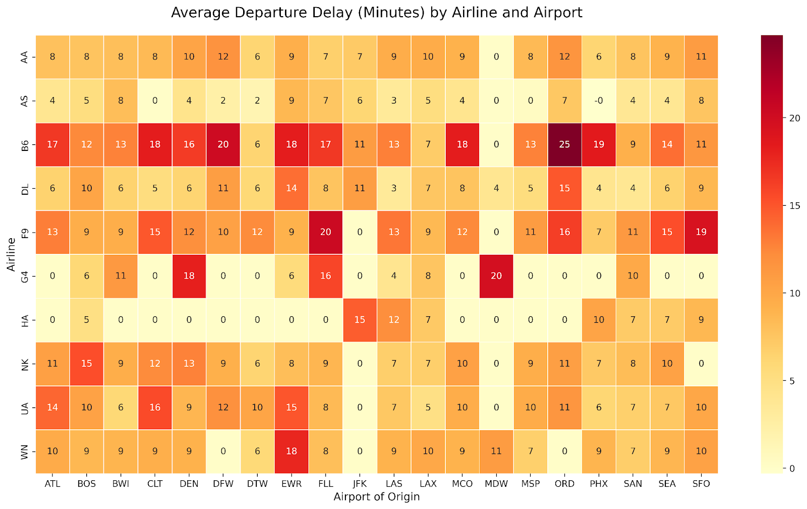
AVG DEPARTURE DELAYS BY AIRPORT PER AIRLINE

Slide 15
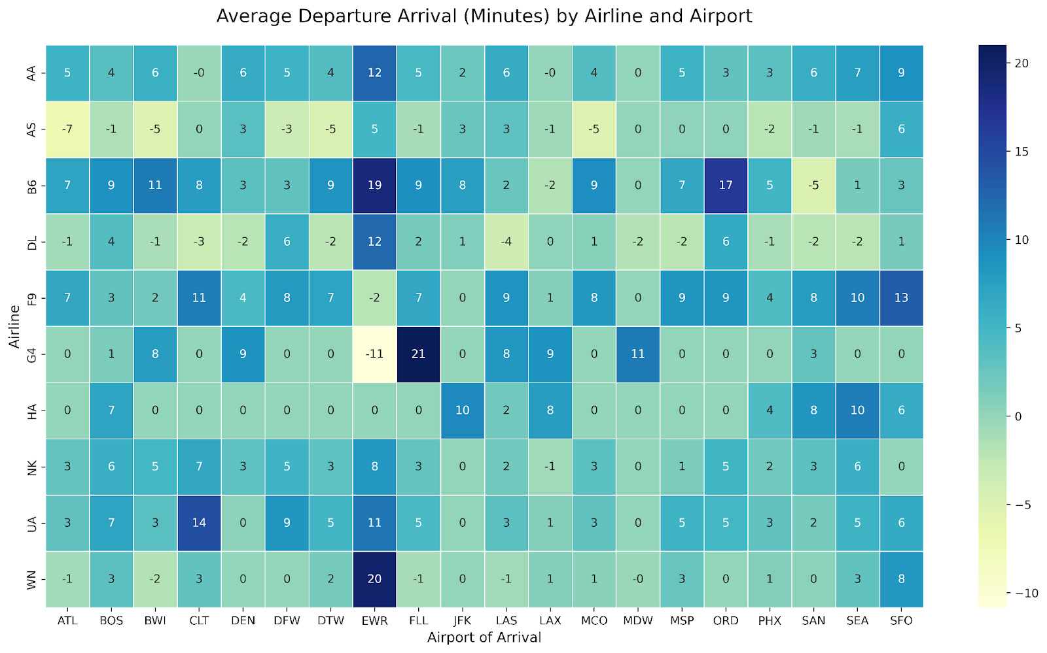
AVG ARRIVAL DELAYS BY AIRPORT PER AIRLINE

Slide 16
CONCLUSION
/Key Takeaways
Airline customer satisfaction reviews seem to suffer from self-selection bias. Distributions of reviews should be viewed through this lens to avoid over-correction in services provided by airlines.
Leisure travelers (86%) dominate; comfort and entertainment matter more than business amenities.
Pain points: Wi-Fi, entertainment, and baggage handling; strength: cabin staff service.
Top complaints: flight problems, baggage issues, and poor customer service (esp. American, United, Spirit).
Data gaps: limited cohesion and self-reported bias from airline datasets — to be addressed in final phase.
Next steps: Improve efficiency at delay-heavy airports, enhance passenger experience, tailor by traveler type, and benchmark leaders (Hawaiian & Delta).

Slide 17
Q&
A
TEAM 06
TH
ANK
YOU

